Slide 1
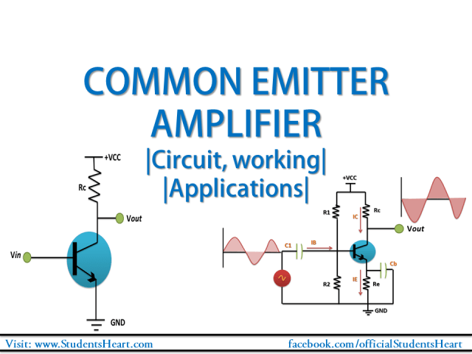
COMPARISON OF THE GAIN VERSUS FREQUENCY RESPONSE OF COMMON EMITTER AND COMMON SOURCES MOSFET AMPLIFIERS.
By Group-3
Electronic Device lab
Sec – w

Slide 2
Group members
Sl.No. | Name | ID
1 | HASSAN, MD. ALIF | 20-42870-1
2 | LEO, NAFINUR | 20-42195-1
3 | HOWLADER, MD. SHAKIB | 20-42752-1
4 | RAHMAN, HASIBUR | 20-42853-1
5 | FAHIM, SHAH NAWAJ | 20-42794-1

Slide 3
Objectives
There we used two type of circuit one is Common Emitter amplifiers and other one is Common Sources MOSFET amplifiers. For this, we have different purposes in this report. The objectives for CE BJT configuration is -
Trace the circuit diagram of a single stage transistor Amplifier;
Measure the maximum signal that can be amplified with the amplifier without any distortion.
Measure the voltage gain of the amplifier at different frequency.
Measure the voltage gain of the amplifier at different values of load resistance.
Measure the BW frequency from CE BJT amplification.

Slide 4
And for CS MOSFET the objectives are –
To become familiar and study the characteristics of MOSFET common source (CS) amplifier.
To determine the voltage gain, input and output voltages by using DC and AC analysis.
To determine the BW frequency of CS MOSFET.

Slide 5
Requirements
We have to collect valid simulated data for both common emitter (CE) BJT and common source (CS) MOSFET amplifiers.
We have to interprete the data with analysis for frequency response of both the amplifiers.
We have to give conclusion with acknowledging the limitations.

Slide 6
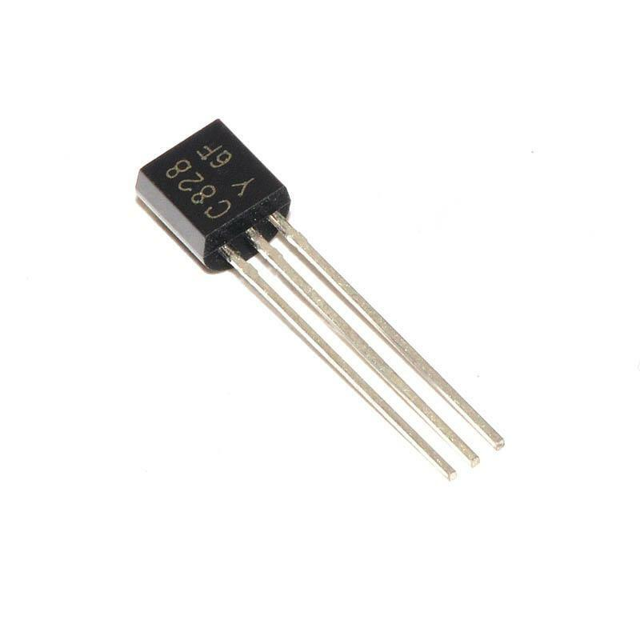
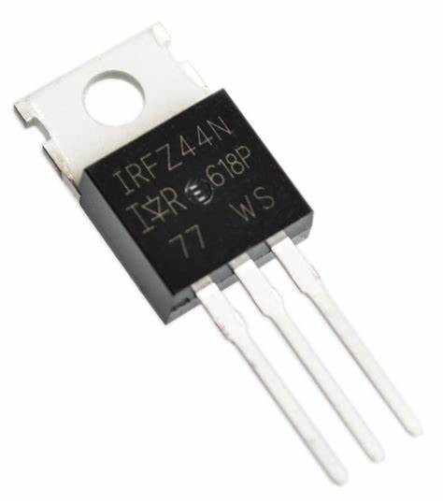
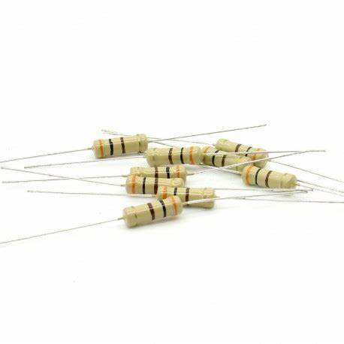
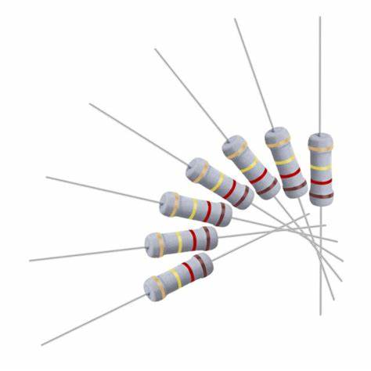
Apparatus
Transistor (C828) 1
MOSFET: n-channel MOSFET 1
33k, 10k, 4.7k, 1k, 3.3k, 1.5k, 330Ω Resistance 1 for each

Slide 7
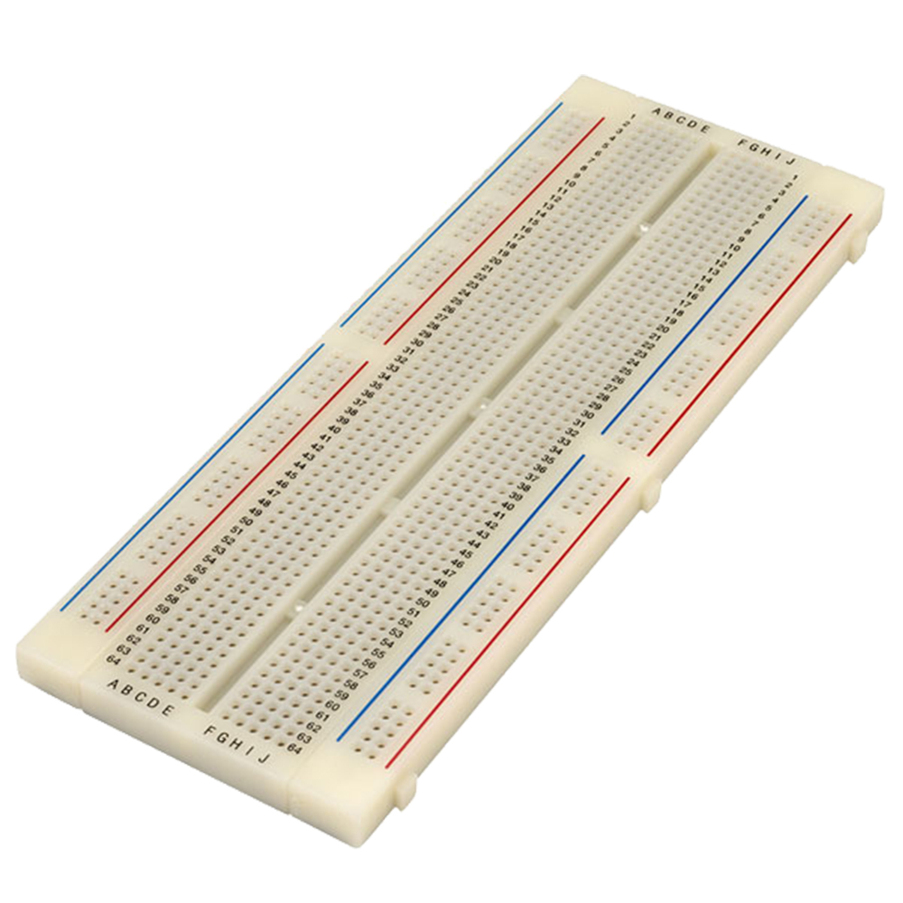
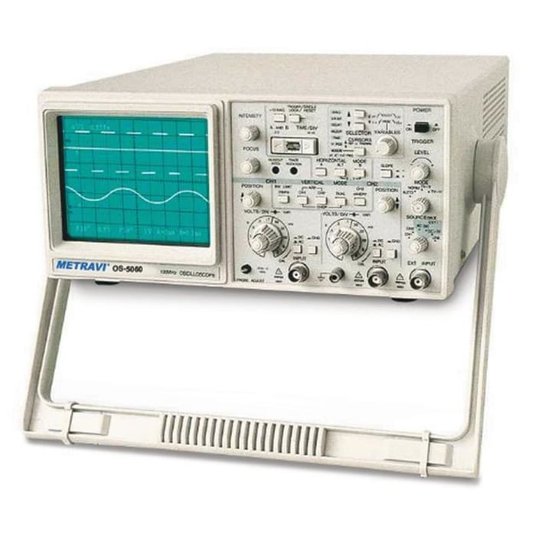

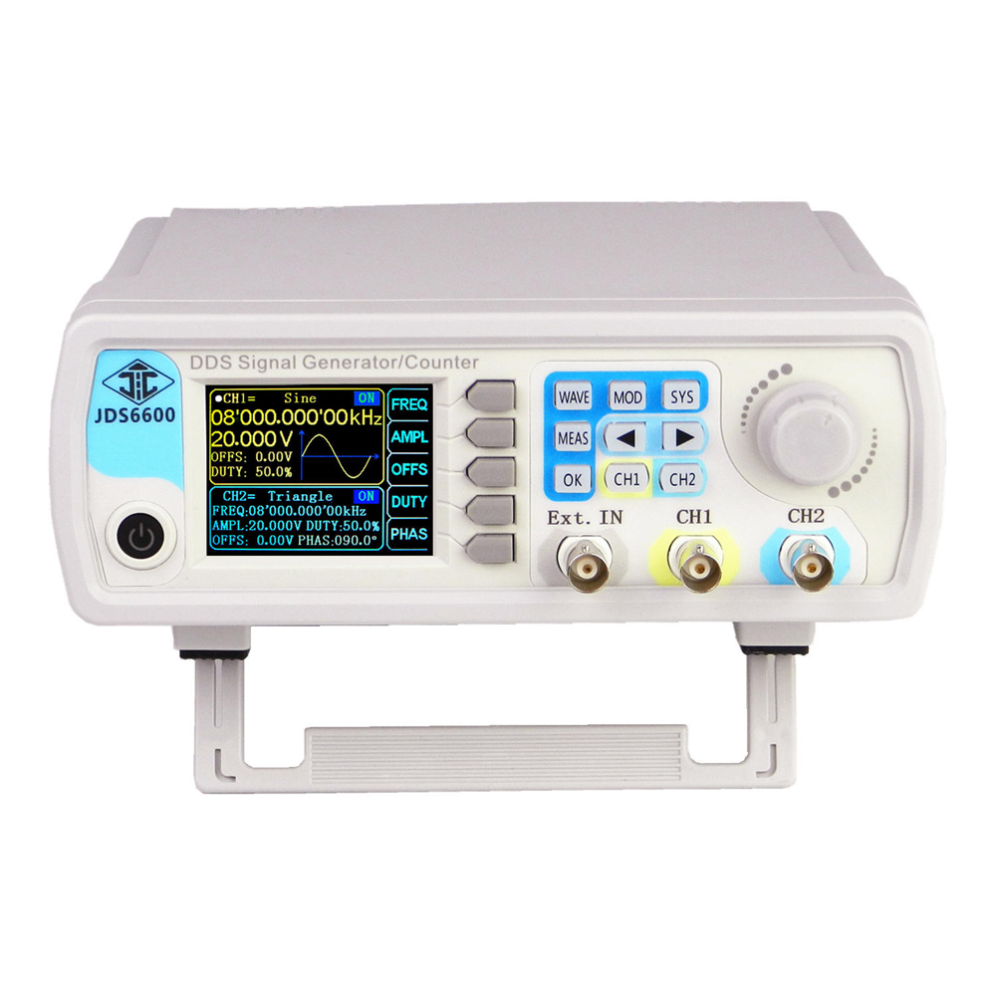
Project Board 1 Cathode Ray Oscilloscope (CRO) 1 Multimeter1 Signal Generator 1

Slide 8
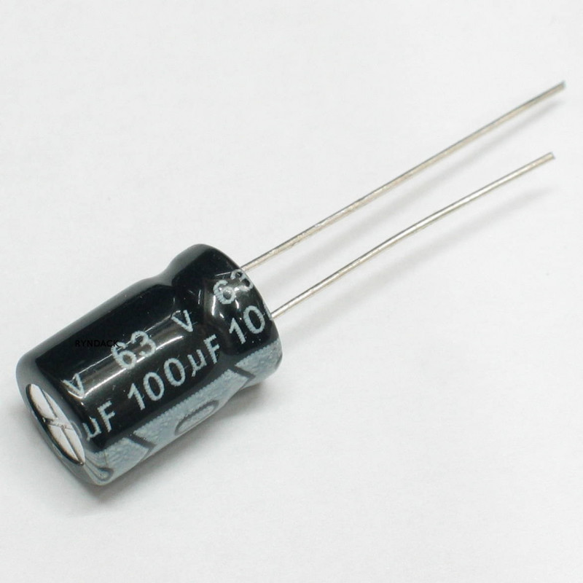

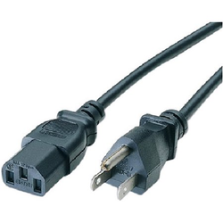
100μF Capacitor 1 Probes 2 Power Supply Cable 2

Slide 9
Steps to be followed
We have to construct the single stage common emitter (CE) BJT and common source (CS) MOSFET amplifiers separately in the simulation platform (like, Multisim)
We have to choose the parameter values for the amplifier circuits.
We have to simulate the circuits for AC Analysis to investigate voltage gain versus frequency response of both the amplifiers.
We have to change the parameter values to attain the required voltage gain, Av.[ The voltage gain, Av, for each group will be decided by the course teacher.]
We have to find the frequency Bandwidth for voltage gain, Av, from the voltage gain versus frequency response curve.
We have to attain certain voltage gain, Av , compare the gain versus frequency response of common emitter (CE) BJT and common source (CS) MOSFET amplifiers.

Slide 10
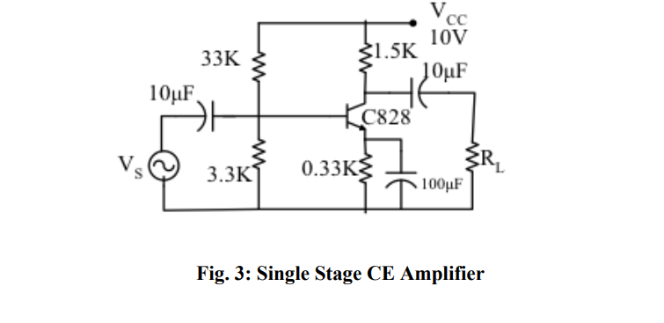
Procedure
For Common Emitter Configuration-
We have to implement the circuit as shown in the figure -3.
We have to feed different AC signal input and observe the input and output on the CRO.
From the output curve we have to calculate voltage gain.
Then from the AC analysis of voltage vs frequency curve we have to find the BW frequency.

Slide 11
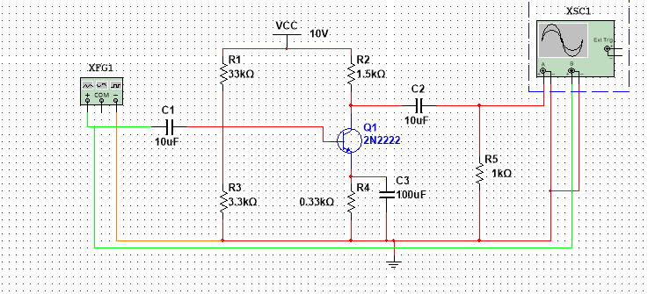
Procedure
For MOSFET Common Emitter Configuration-
We have constructed the circuit as shown in figure
We have applied AC input voltage for different frequencies and observed the output signals from the CRO.
We have measured the output voltage and computed the voltage gain.
We have measured bandwidth from AC analysis.

Slide 12
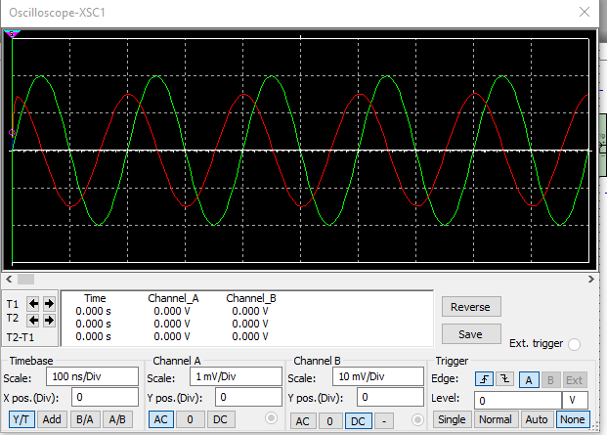
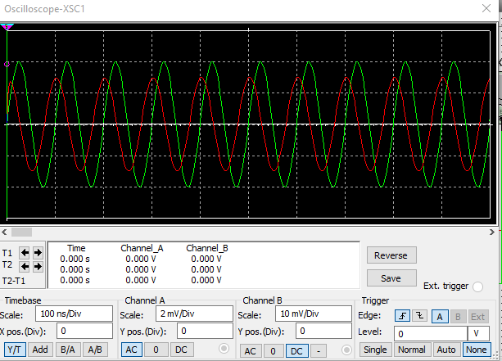
Data Analysis: Simulation part for Common Emitter BJT
Common Emitter BJT

Slide 13
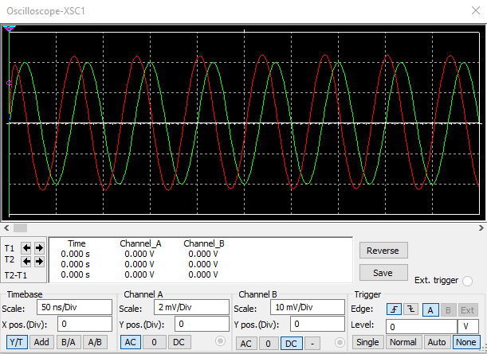
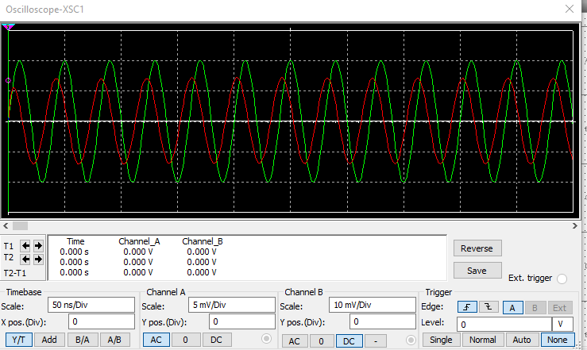
Common Emitter BJT

Slide 14
Data Table - 1: For Common Emitter (CE) configuration for a BJT -
Serial No | Frequency | Input Voltage | Output Voltage | Voltage Gain | Voltage Gain in dB
1 | 100 HZ | 20 mv | 0.45 V | 22.5 | 27.04
2 | 500 HZ | 20 mv | 0.72 V | 36 | 31.12
3 | 1 KHZ | 20 mv | 0.84 V | 42 | 32.46
4 | 2 KHZ | 20 mv | 1.4 V | 70 | 36.90

Slide 15
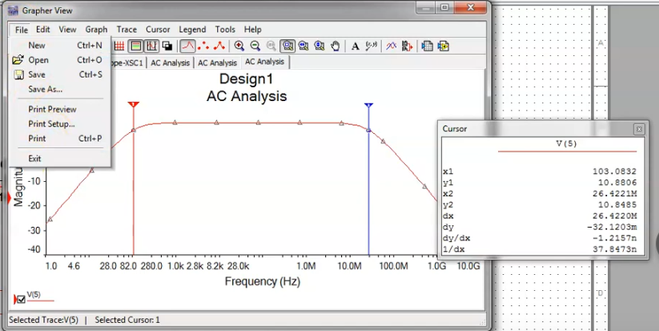
Graph for finding Bandwidth
Lower Cut-off Frequency: 103.08 Hz
Higher Cut-off Frequency: 26.422 MHz
Bandwidth, BW of CE BJT Amplifier: 26.422 MHz

Slide 16
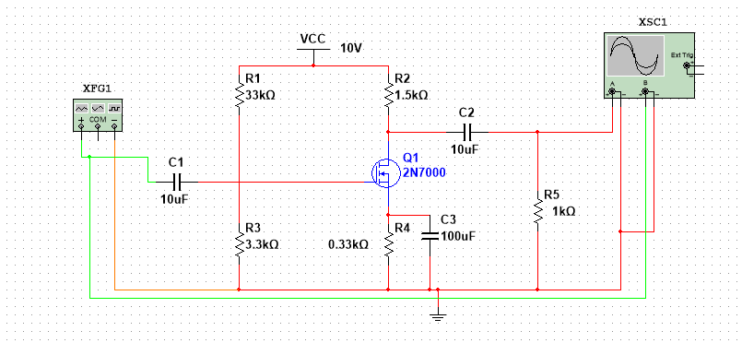
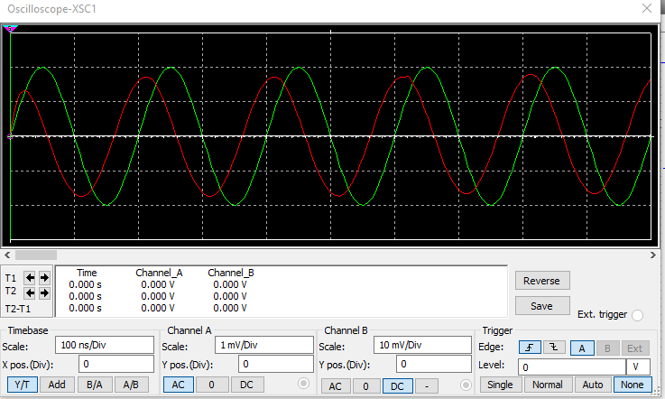
Data Analysis: Simulation part for Common Source MOSFET
Common Source MOSFET

Slide 17
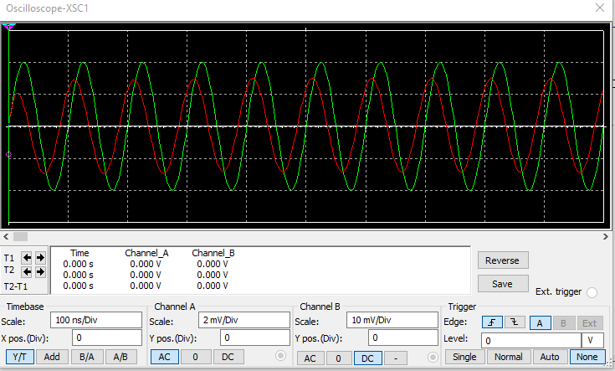
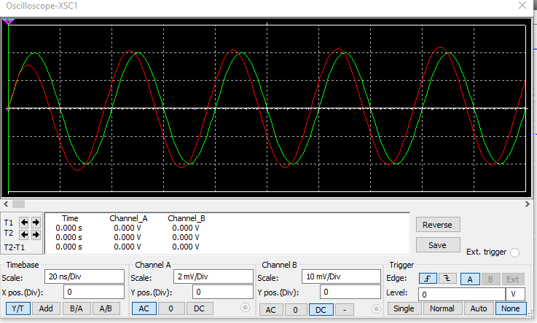
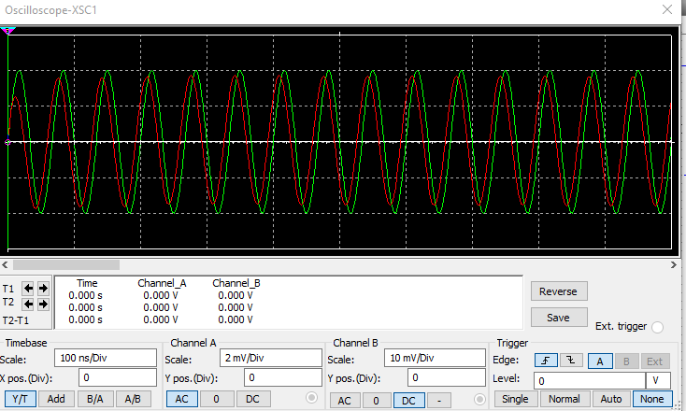
Data Analysis: Simulation part for Common Source MOSFET
Common Source MOSFET

Slide 18
Data Table - 2: For common source (CS) amplification for a MOSFET -
Serial No | Frequency | Input Voltage | Output Voltage | Voltage Gain | Voltage Gain in dB
1 | 100 HZ | 20 mv | 0.35 V | 17.5 | 28.64
2 | 500 HZ | 20 mv | 0.642 V | 32.1 | 30.13
3 | 1 KHZ | 20 mv | 0.76 V | 38 | 31.60
4 | 2 KHZ | 20 mv | 1.1 V | 55 | 34.80

Slide 19
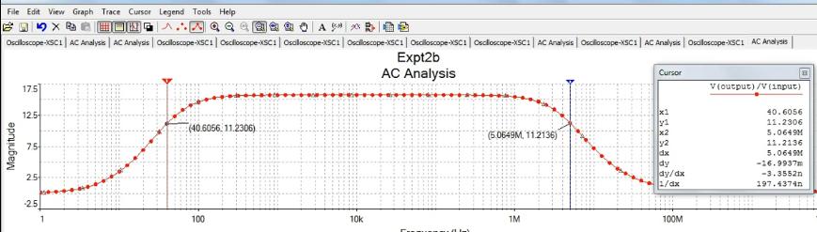
Graph for finding Bandwidth
Lower Cut-off Frequency: 40.60 HZ
Higher Cut-off Frequency: 5.06 MHz
Bandwidth, BW of CS MOSFET Amplifier: 5.06 MHZ

Slide 20
Purpose
This is a statement of the problem to be investigated. It provides the overall direction for laboratory investigation and must be addressed in the conclusion.

Slide 21
DISCUSSION & Conclusions
The dc power source needs to be switched off while changing the transistor. The trainer board needs to be checked if working properly. The circuit was connected properly and was also checked before taking the readings. In this way, we can measure maximum signal, voltage gain, bw of a frequency etc.

Slide 22
THANK YOU !

